Slide 1
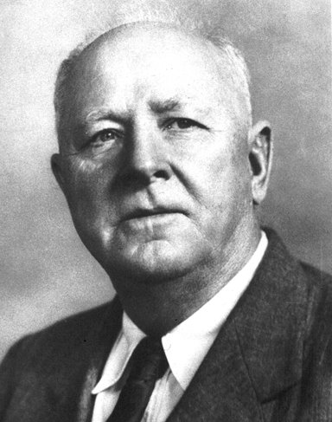
- Hugh Hammond Bennett
“If we are bold in our thinking, courageous in accepting new ideas, and willing to work with instead of against our land, we shall find in conservation farming an avenue to the greatest food production the world has ever known.”

Slide 2
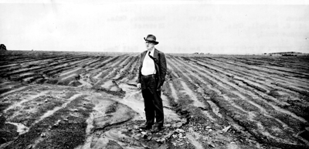
- Hugh Hammond Bennett
“If you will take the trouble to ascertain the facts about our farmland – and other natural resources – and then lend your support to our conservation program, we will get results and hold onto them. To stand by silently will not help.”

Slide 3

What is CART
Conservation Assessment Ranking Tool
Set of business practices to streamline conservation planning and program delivery.
Program neutral integrated information technology software application. Any USDA program!

Slide 4
Why CART
NRCS Must Streamline.
Chief Priorities
Implement 2018 Farm Bill and streamline process and program delivery.
Improve Customer Service
Secretary Priorities
Streamline Programs
Increase Efficiency
Improve Customer Service
Customers/Partners/Field Offices/NRCS of Future =>
Simplify - Streamline

Slide 5
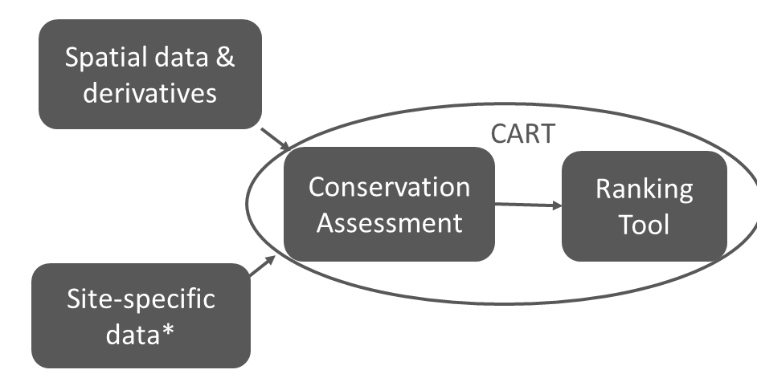
CART Structure

Slide 6
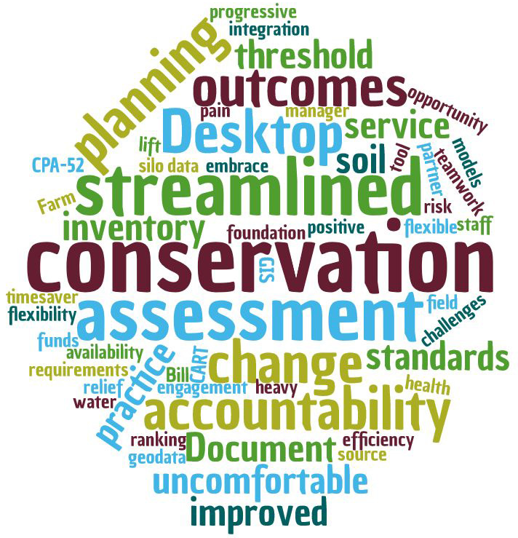

Slide 7
Than k You for attending!

